Slide 1

Textual analysis of movie reviews
Team 2
Hang Ding
Fangling Zhang
Qingquan Zhao
Yihao Zhou
Tongge Zhu

Slide 2
Flowchart
Movie Dataset
(1000 positive and 1000 negative processed reviews)
Import data
Train/Test data split
Finding the right plot
Feature extraction
Classification

Slide 3
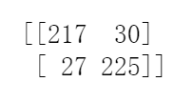
Problem 1: Go thought the flowchart
Preliminary result
Data_train : 75%
Data_test: 25%
T P | F P
F N | T N
fit.transform(Data_train)
transform(Data_test)
Classification

Slide 4
Problem 2: Explore the TfidVectorizer class
TF-IDF is a numerical statistics term that is intended to reflect how important a word is to a document in a collection or corpus.
TF: Term frequency, the number of times a term occurs.
IDF: Inverse document frequency, the specificity of a term can be quantified as an inverse function of the number of documents in which it occurs

Slide 5
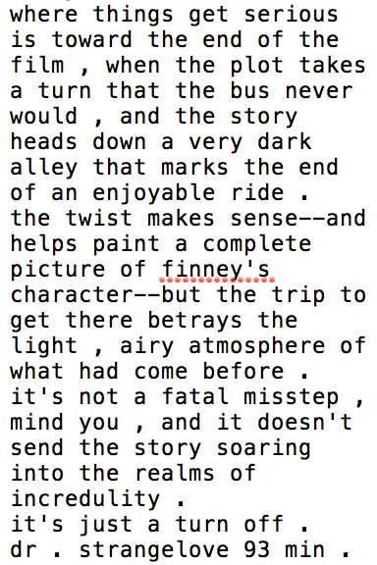
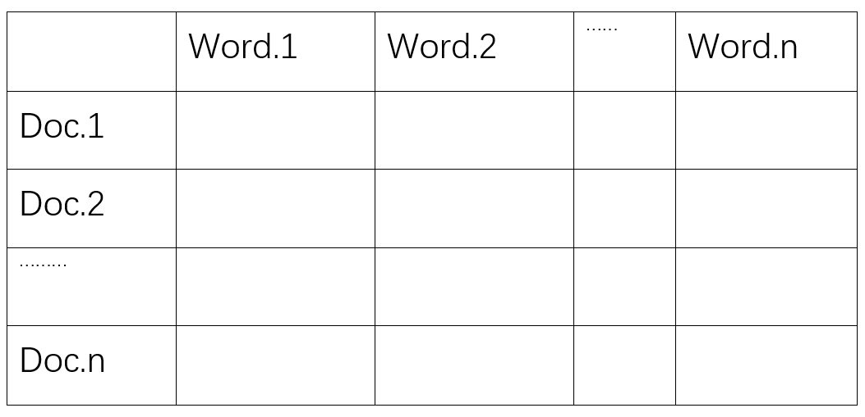
Feature extraction
Text
features
1500

Slide 6
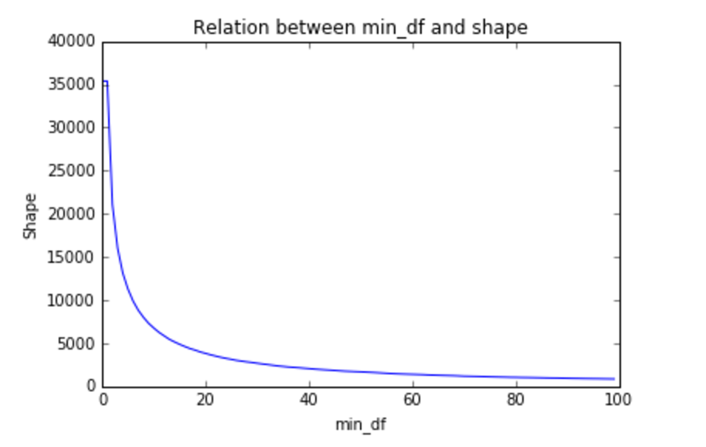
Relationship between min_df and shape
min_df:
When building the vocabulary ignore terms that have a document frequency strictly lower than the given threshold
When min_df is larger, the shape of vectorized result is smaller and we will get less features.
Notes:
If float, the parameter represents a proportion of documents, integer absolute counts.

Slide 7
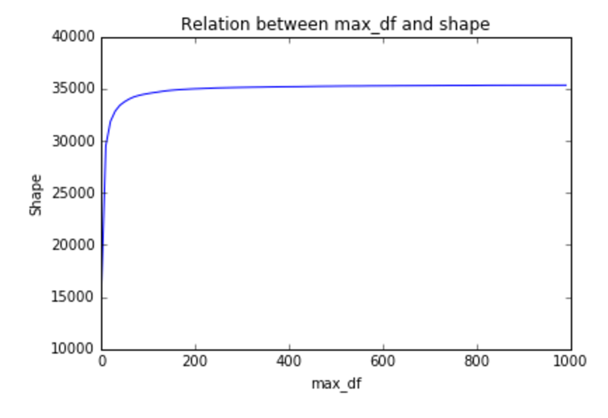
Relationship between max_df and shape
max_df:
When building the vocabulary ignore terms that have a document frequency strictly higher than the given threshold.
When max_df is smaller, the shape of vectorized result is smaller and we will get less features.

Slide 8
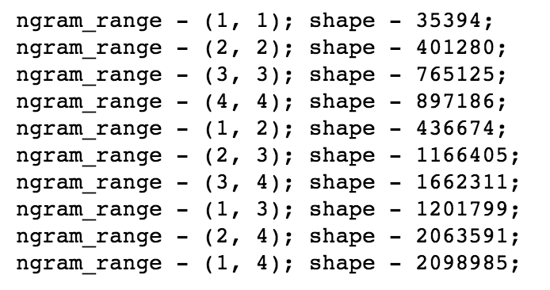
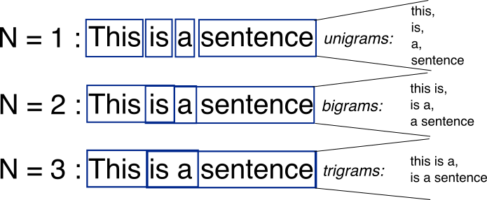
n_gram_range and shape
an n-gram is a contiguous sequence of n items from a given sequence of text or speech.
In our case:
Example:
n_gram_range
eg: {1,3} = {1,1} + {2,2} + {3,3}

Slide 9
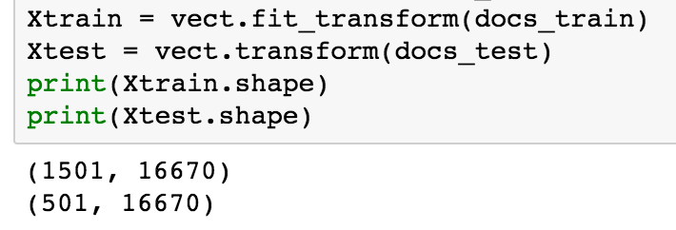
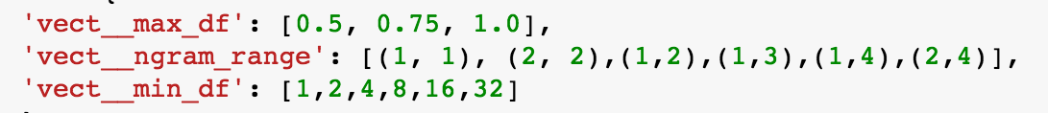
Problem 3: Machine learning algorithms
Classification
Nearest Neighbors Classification (C :[5, 20])
Linear Support Vector Classification (C:[1, 500, 1000])

Slide 10
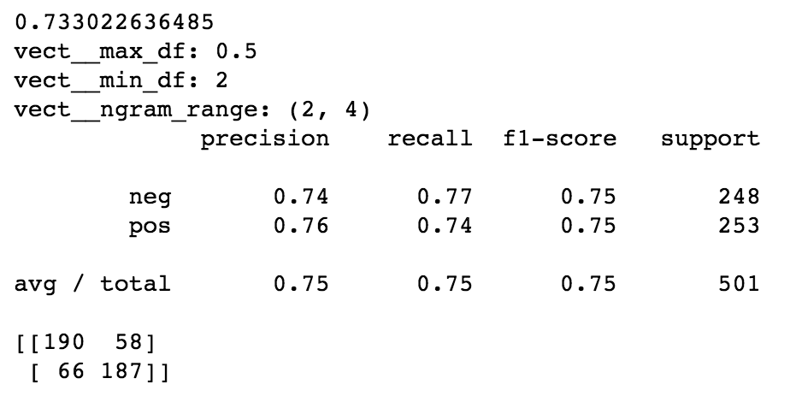
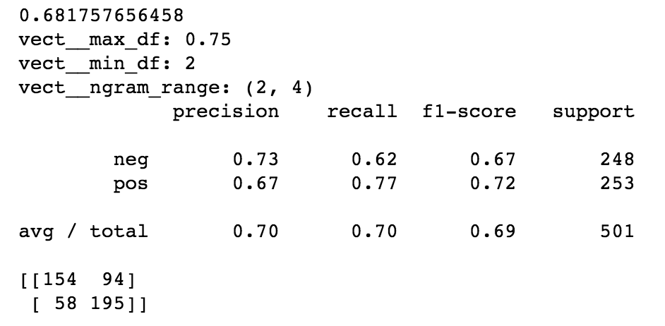
Nearest Neighbors Classification
n_neighbors = 20
n_neighbors = 5
Notes:
http://scikit-learn.org/stable/modules/neighbors.html#classification

Slide 11
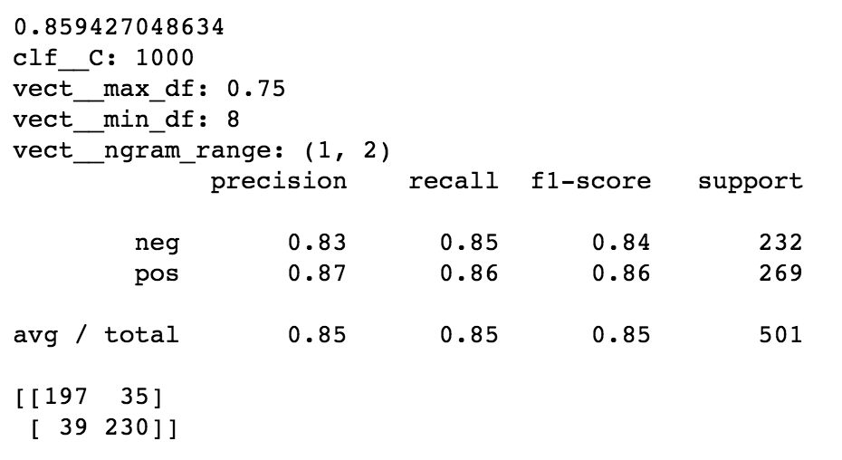
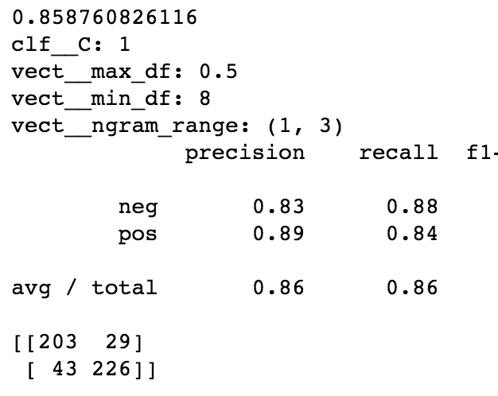

Linear Support Vector Classification
Both parameters combination can give good predicting results.
Notes:
In summary, based on our studies and parameters we screened for, we identified that Linear Support Vector Machine offers us the highest prediction accuracy in our case.

Slide 12
Two wrong prediction examples
movie name: “Love is devil”:
Actual: Positive
Prediction: Negative
movie name: “Star Wars the Phantom Menace”:
Actual: Negative
Prediction: Positive
.

Slide 13
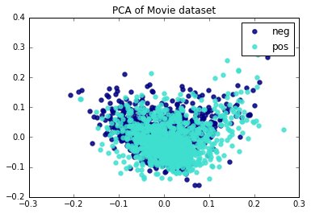
Problem 4： Finding the right plot
Principal component analysis (PCA)
Linear dimensionality reduction using Singular Value Decomposition of the data to project it to a lower dimensional space.

Slide 14
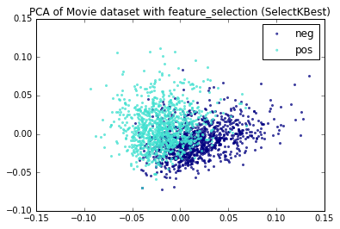
Feature selection
Decrease the # of features
34146
600
Notes:
Select features according to the k highest scores.
f_classif （我们用的是这个）
ANOVA F-value between label/feature for classification tasks.
mutual_info_classif
Mutual information for a discrete target.
chi2 （）
Chi-squared stats of non-negative features for classification tasks.

Slide 15
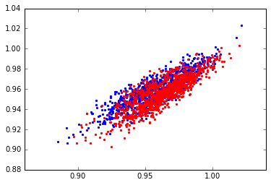
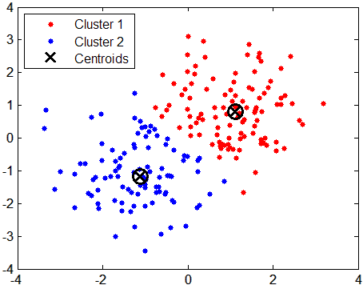

Cluster Movie data by k-Means algorithm
The KMeans algorithm clusters data by trying to separate samples in n groups of equal variance, minimizing a criterion known as the inertia or within-cluster sum-of-squares.
KMeans of Movie dataset
Notes:
The KMeans algorithm clusters data by trying to separate samples in n groups of equal variance, minimizing a criterion known as the inertia or within-cluster sum-of-squares.

Slide 16
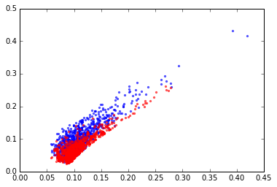
Feature selection plus k-Means cluster
Decrease the # of features
KMeans of Movie dataset with SelectKbest
34146
20

Slide 17
Thanks for your attention!

Slide 18
